Slide 1
Apache Camel
Powerful yet Lightweight Integration Framework

Slide 2
What is Camel
Concrete implementation of Enterprise Integration Patterns from Bob Hohpes classic book by the same name
A large collection of components available out-of-the-box
Powerful DSL for declaring your routes
”A way of of tying together different products and standards using a standardized language and well tested integration patterns”

Slide 3
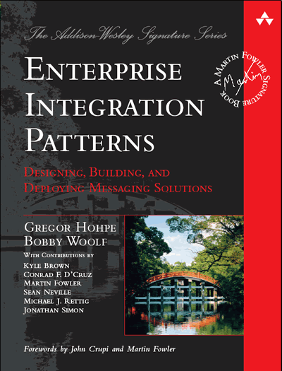
Enterprise Integration Patterns
Defines well known patterns for how to use integrate software using messaging.
“Patterns are not invented, but rather discovered and observed from actual practice in the field”
Gergor Hohpe – Enterprise Integration Patterns (2004)

Slide 4
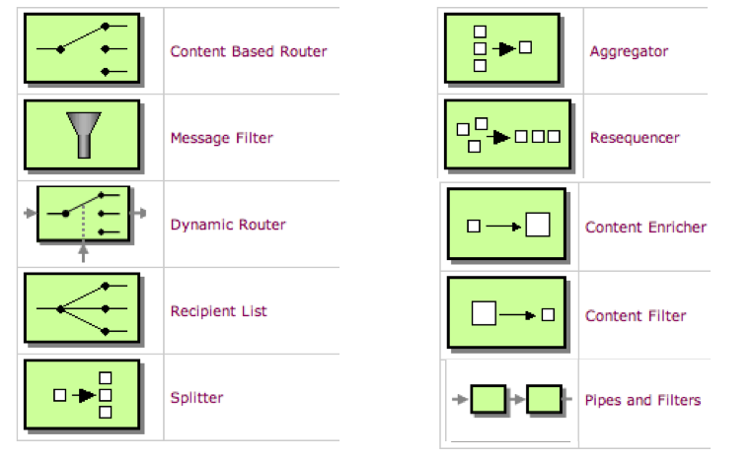
Enterprise Integration Patterns
http://www.enterpriseintegrationpatterns.com/
http://camel.apache.org/enterprise-integration-patterns.html

Slide 5
Camel Components
A component can implement and endpoint to a technology, such as file, http, ActiveMQ etc
A component can also encapsulate and facilitate usage of a framework, such as CXF, Mustache, Metrics etc
Components can both trigger traffic (for instance starting a timed job via the Quartz Scheduler) and receive traffic (for instance by saving a record using the MongoDB component)
Over 150+ components are available today, and growing by each release

Slide 6
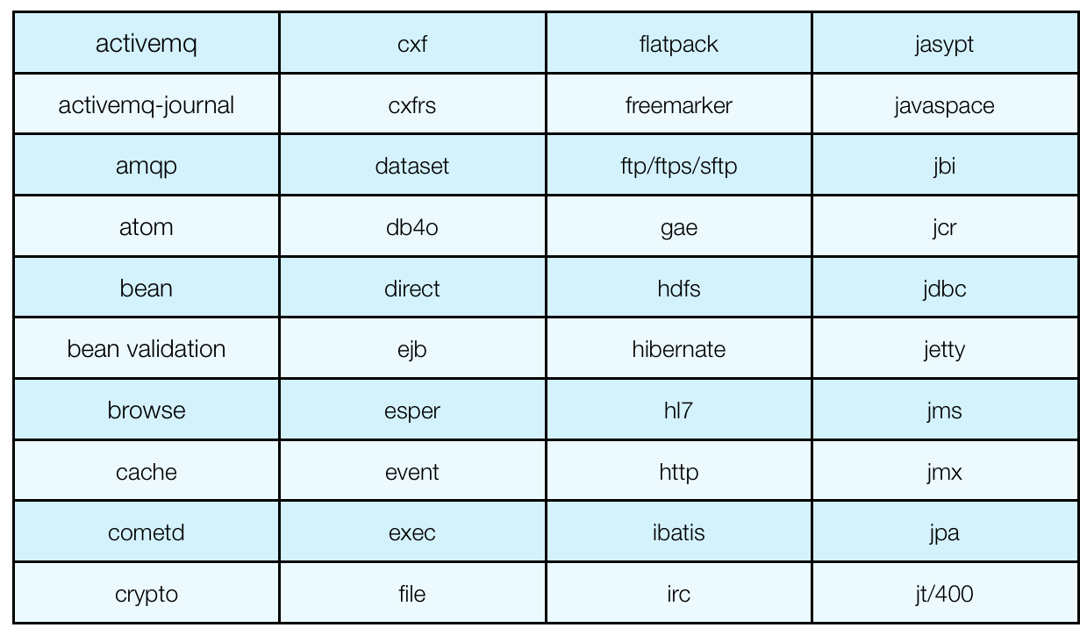
Camel Components
http://camel.apache.org/components.html

Slide 7
Camel DSL
DSL stands for Domain Specific Language
Camel routes can be defined using XML, Java, Groovy, Scala or Kotlin.

Slide 8
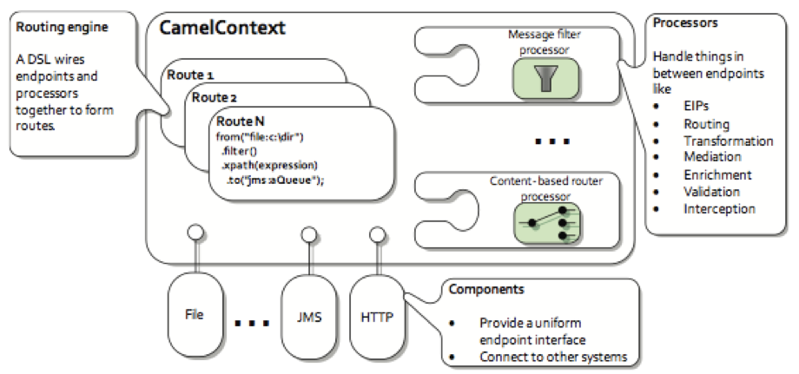
Camel Architecture

Slide 9
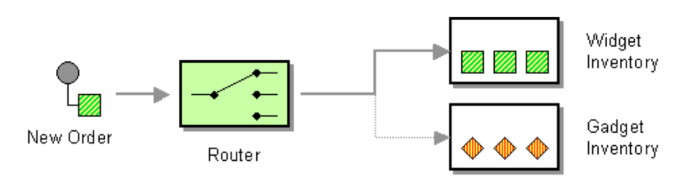
What is Apache Camel?
EIP - Content Based Router
Notes:
5/24/16
9
9

Slide 10
ç
from newOrder
Notes:
5/24/16
10
10

Slide 11
ç
from newOrder
choice
Notes:
5/24/16
11
11

Slide 12
ç
from newOrder
choice
when isWidget to widget
Notes:
5/24/16
12
12

Slide 13
ç
from newOrder
choice
when isWidget to widget
otherwise to gadget
Notes:
5/24/16
13
13

Slide 14
ç
from(newOrder)
choice
when(isWidget) to(widget)
otherwise to(gadget)
Notes:
5/24/16
14
14

Slide 15
ç
from(newOrder)
.choice()
.when(isWidget).to(widget)
.otherwise().to(gadget);
Notes:
5/24/16
15
15

Slide 16
ç
Endpoint newOrder = endpoint("activemq:queue:newOrder");
from(newOrder)
.choice()
.when(isWidget).to(widget)
.otherwise().to(gadget);
Notes:
5/24/16
16
16

Slide 17
ç
Endpoint newOrder = endpoint("activemq:queue:newOrder");
Predicate isWidget = xpath("/order/product = 'widget'");
from(newOrder)
.choice()
.when(isWidget).to(widget)
.otherwise().to(gadget);
Notes:
5/24/16
17
17

Slide 18
ç
Endpoint newOrder = endpoint("activemq:queue:newOrder");
Predicate isWidget = xpath("/order/product = 'widget'");
Endpoint widget = endpoint("activemq:queue:widget");
Endpoint gadget = endpoint("activemq:queue:gadget");
from(newOrder)
.choice()
.when(isWidget).to(widget)
.otherwise().to(gadget);
Notes:
5/24/16
18
18

Slide 19
What is Apache Camel?
Java Code
ç
public void configure() throws Exception {
Endpoint newOrder = endpoint("activemq:queue:newOrder");
Predicate isWidget = xpath("/order/product = 'widget'");
Endpoint widget = endpoint("activemq:queue:widget");
Endpoint gadget = endpoint("activemq:queue:gadget");
from(newOrder)
.choice()
.when(isWidget).to(widget)
.otherwise().to(gadget)
.end();
}
Notes:
5/24/16
19
19

Slide 20
What is Apache Camel?
Java Code
ç
import org.apache.camel.Endpoint;
import org.apache.camel.Predicate;
import org.apache.camel.builder.RouteBuilder;
public class MyRoute extends RouteBuilder {
public void configure() throws Exception {
Endpoint newOrder = endpoint("activemq:queue:newOrder");
Predicate isWidget = xpath("/order/product = 'widget'");
Endpoint widget = endpoint("activemq:queue:widget");
Endpoint gadget = endpoint("activemq:queue:gadget");
from(newOrder)
.choice()
.when(isWidget).to(widget)
.otherwise().to(gadget)
.end();
}
}
Notes:
5/24/16
20
20

Slide 21
What is Apache Camel?
Camel Java DSL
ç
import org.apache.camel.builder.RouteBuilder;
public class MyRoute extends RouteBuilder {
public void configure() throws Exception {
from("activemq:queue:newOrder")
.choice()
.when(xpath("/order/product = 'widget'"))
.to("activemq:queue:widget")
.otherwise()
.to("activemq:queue:gadget")
.end();
}
}
Notes:
5/24/16
21
21

Slide 22
What is Apache Camel?
Camel XML DSL
ç
<route>
<from uri="activemq:queue:newOrder"/>
<choice>
<when>
<xpath>/order/product = 'widget'</xpath>
<to uri="activemq:queue:widget"/>
</when>
<otherwise>
<to uri="activemq:queue:gadget"/>
</otherwise>
</choice>
</route>
Notes:
5/24/16
22
22

Slide 23
What is Apache Camel?
Endpoint as URIs
ç
<route>
<from uri="file:inbox/orders"/>
<choice>
<when>
<xpath>/order/product = 'widget'</xpath>
<to uri="activemq:queue:widget"/>
</when>
<otherwise>
<to uri="activemq:queue:gadget"/>
</otherwise>
</choice>
</route>
use file instead
Notes:
5/24/16
23
23

Slide 24
What is Apache Camel?
Endpoint as URIs
ç
<route>
<from uri="file:inbox/orders?delete=true"/>
<choice>
<when>
<xpath>/order/product = 'widget'</xpath>
<to uri="activemq:queue:widget"/>
</when>
<otherwise>
<to uri="activemq:queue:gadget"/>
</otherwise>
</choice>
</route>
parameters
Notes:
5/24/16
24
24

Slide 25
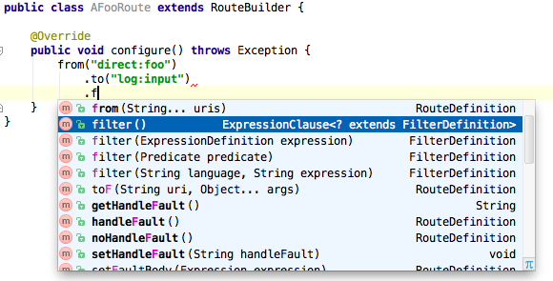
Standard Java or XML
Java DSL is just Java
Notes:
5/24/16
25
25

Slide 26
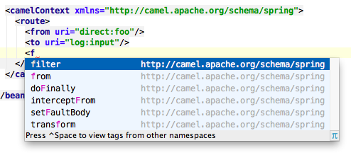
Standard Java or XML
XML DSL is just XML
… with XSD schema for validation/tooling
Notes:
5/24/16
26
26

Slide 32
Camel - Message
Every message consists of
A unique MessageId
Zero or more headers in the format key = Value. Keys are Strings but values can be any Object.
Zero or more attachments, used primarily by email component, otherwise seldom used.
Body of type Object. Can be converted in a route manually or automatically to other types.

Slide 33
Camel - Exchange
Holds information as a message passes through an entire route. Contains
A unique Id that identifies the Exchange
Message Exchange Pattern: InOnly (no response sent) or InOut (response returned to Producer)
Exception is set if an error occurs during routing
Properties are kept during the lifetime of an Exchange.
In message contains the message
Out message is only used with InOut messages, and contains the response message)

Slide 34
Camel - CamelContext
The CamelContext is the Camel runtime system, which keeps all the pieces together.
Contains all your defined routes, endpoints, components, processes etc.
More than one CamelContext can exist. They will then be isolated from each other.

Slide 35
Training – Part 1 – Camel
Copy code from CamelTraining1
Read the code and understand what it does
Copy the CamelTraining1 directory under data/ to the correct location
Build using maven and install using the karaf console
Install using mvn: notation
Make sure it works as intended
Notes:
install -s mvn:se.su.camel/camel-training1/1.0.0-SNAPSHOT

Slide 36
Training – Part 2 – Camel
The camel route does nothing interesting – let’s beef it up!
Create a content based router, and move the message to out/good or out/bad based on the school field
Use xpath to parse the xml

Slide 37
Solution
from("file:/tmp/CamelTraining1/in")
.choice()
.when(xpath("/person/school = 'Orebro Universitet'"))
.log("Top Notch School")
.to("file:/tmp/CamelTraining1/out/good")
.otherwise()
.log("Other School")
.to("file:/tmp/CamelTraining1/out/mediocre");

Slide 38
Training – Part 3 – Camel contd.
Now rewrite the route using XML and blueprint
Use the blueprint archetype to create the project
mvn archetype:generate -DarchetypeGroupId=org.apache.camel.archetypes -DarchetypeVersion=2.16.1 -DarchetypeArtifactId=camel-archetype-blueprint

Slide 39
Solution
<camelContext id="blueprint-camel-context" xmlns="http://camel.apache.org/schema/blueprint">
<route id="best-school">
<from uri="file:/tmp/CamelTraining1/in"/>
<choice>
<when>
<xpath>/person/school = "Orebro Universitet"</xpath>
<to uri="file:/tmp/CamelTraining1/out/good"/>
</when>
<otherwise>
<to uri="file:/tmp/CamelTraining1/out/mediocre"/>
</otherwise>
</choice>
</route>
</camelContext>

